Slide 1
Week 10
Communication

Slide 2
The communication process
Communication is
  an interpersonal process of sending and receiving symbols with messages attached to them.
  the transfer and understanding of meaning
The communication process can be viewed as a series of questions:
  ‘Who?’ (sender)
  ‘says what?’ (message)
  ‘in what way?’ (channel)
  ‘to whom?’ (receiver)
  ‘with what result?’ (interpreted meaning).
Notes:
The communication process
Communication is an interpersonal process of sending and receiving symbols with messages attached to them.
The key elements in the communication process include a sender, who is responsible for encoding an intended message into meaningful symbols, both verbal and non-verbal. The message is sent through a communication channel to a receiver, who then decodes or interprets its meaning. This interpretation, importantly, may or may not match the sender’s original intentions. Feedback, when present, reverses the process and conveys the receiver’s response to the sender.
Another way to view the communication process is as a series of questions. ‘Who?’ (sender) ‘says what?’ (message) ‘in what way?’ (channel) ‘to whom?’ (receiver) ‘with what result?’ (interpreted meaning).

Slide 3
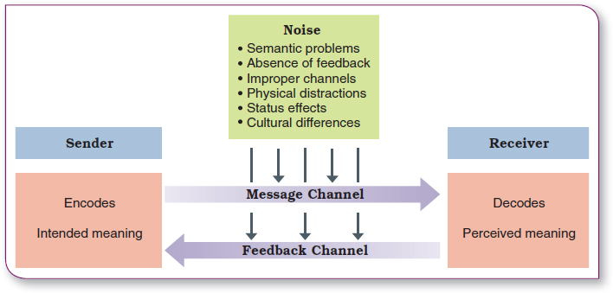
The communication process
Notes:
The process of interpersonal communication.

Slide 4
Methods of Communication(1/2)
Oral Communication
  Face-to-face conversation, group discussions, telephone calls, etc.
Written Communication
  memos, letters, reports, notes, and e-mails, etc.
Advantages | Disadvantages
• Promotes prompt feedback and interchange • Easy | • May suffer from inaccuracies • Leaves no permanent record • Seldom leaves time for a thorough response
Advantages | Disadvantages
• Tends to be more accurate • Provides a record of the communication | • Inhibits feedback and interchange • Is more difficult and time-consuming
Notes:
The communication process
Communication is an interpersonal process of sending and receiving symbols with messages attached to them.
The key elements in the communication process include a sender, who is responsible for encoding an intended message into meaningful symbols, both verbal and non-verbal. The message is sent through a communication channel to a receiver, who then decodes or interprets its meaning. This interpretation, importantly, may or may not match the sender’s original intentions. Feedback, when present, reverses the process and conveys the receiver’s response to the sender.
Another way to view the communication process is as a series of questions. ‘Who?’ (sender) ‘says what?’ (message) ‘in what way?’ (channel) ‘to whom?’ (receiver) ‘with what result?’ (interpreted meaning).

Slide 5
Methods of Communication(2/2)
Nonverbal communication
  facial expressions, body movements, physical contact, gestures and inflection/tone of voice.
55 percent of a message’s content is transmitted by facial expression and body posture
38 percent of a message’s content is derived from inflection and tone
7 percent of a message’s content is derived from the words themselves.

Slide 6
Barriers to effective communication
Effective communication is a two-way process that requires effort and skill on the part of both the sender and the receiver.
Noise: Anything that interferes with the effectiveness of the communication process.
Communication channel: The medium through which a message is conveyed from sender to receiver.
  Written channels are best for simple messages requiring extensive dissemination.
  Oral channels are best for complex messages where immediate feedback in valuable.
Notes:
Barriers to effective communication
Effective communication is a two-way process that requires effort and skill on the part of both the sender and the receiver.
Noise is anything that interferes with the effectiveness of the communication process. For instance, translating from one language to another can often lead to a loss of intended meaning.
A communication channel is the medium through which a message is conveyed from sender to receiver. Good managers choose the right communication channel, or combination of channels, to accomplish their intended purpose in a given situation.
In general, written channels are acceptable for simple messages that are easy to convey and for those that require extensive dissemination quickly. They are also important, at least as follow-up communications, when formal policy or authoritative directives are being conveyed. Oral channels work best for messages that are complex and difficult to convey, where immediate feedback to the sender is valuable. They are also more personal and can create a supportive, even inspirational, emotional climate.

Slide 7
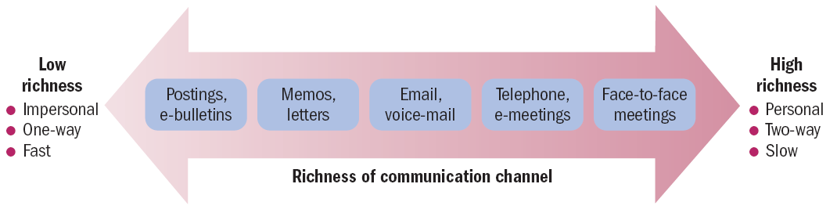
Improving communication:
Use of channels
Notes:
Use of communication channels
Channel richness is the capacity of a channel or communication medium to carry information in an effective manner.
Face-to-face communication, for example, is very high in richness, enabling personal two-way interaction and real-time feedback. At the other end of the continuum, posted email or hard-copy bulletins are very low in richness, representing impersonal one-way interaction and largely insulated from quick feedback.
There are a number of steps that can be taken to keep communication channels open to reduce the harmful consequences of status effects and filtering, described earlier. A popular approach is called management by wandering around or MBWA. This means dealing directly with subordinates by regularly spending time walking around and talking with them about a variety of work-related matters. Instead of relying on less rich and more formal channels to bring information to your attention, MBWA involves finding out for yourself what is going on in a rich face-to-face communication channel.

Slide 8
Barriers to effective communication
Individual barriers | Organisational barriers
• Conflicting or inconsistent cues • Credibility about the subject • Reluctance to communicate • Poor listening • Predisposition about the subject | • Semantics • Status or power differences • Different perceptions • Noise • Overload

Slide 9
Barriers to Effective Communication
Filtering
National
Culture
Information
Overload
Socialculture-
Jargon
Interpersonal Communication
Emotions
- defensiveness
Copyright © 2010 Pearson Education, Inc. Publishing as Prentice Hall
14–<number>
Notes:
Filtering
The deliberate manipulation of information to make it appear more favorable to the receiver.
Emotions
Disregarding rational and objective thinking processes and substituting emotional judgments when interpreting messages.
Information Overload
Being confronted with a quantity of information that exceeds an individual’s capacity to process it.
Defensiveness
When threatened, reacting in a way that reduces the ability to achieve mutual understanding.
Language
The different meanings of and specialized ways (jargon) in which senders use words can cause receivers to misinterpret their messages.
National Culture
Culture influences the form, formality, openness, patterns, and use of information in communications.
上小学的小明特别聪明，心算能力很强。有一天，老师又出了一道心算题目来考考他。
有一辆公共汽车，车上有28个人。到了一站，上了18人，下3
上5下20
上16下2
上4下18
上7下4
上2下5
上了6人，下了10人。
这辆车停了多少站？
Defensiveness: “这个方案的预算部分不行啊得改一下”“这部分不是我做的／我是照着去年的方案改的”
“下雨记得带伞哦”“我又不是傻子，下雨当然带伞了！上次没带是你说降水概率40%的！”
史上最牛女秘书
间或
大肉包子
“我酸了”“每天跑完步去冲个澡，把衣服也换了，要不就是酸了，人前有味道呢”
大写表示愤怒
Can you please open the window? Yes I can.
房东总是羞辱我们叫我们滚回自己的国家去

Slide 10
Improving communication:
Individual skills | Organisational skills
• Develop good listening skills • Encourage two-way communication • Be aware of language and meaning • Maintain credibility • Be sensitive to receiver’s perspective • Be sensitive to sender’s perspective | • Follow-up • Regulate information flows • Understand the richness of media
Notes:
Active listening
Active listening is the process of taking action to help the source of a message say exactly what he or she really means.
There are five rules for being an active listener.
1. Listen for message content. Try to hear exactly what content is being conveyed in the message.
2. Listen for feelings. Try to identify how the source feels about the content in the message.
3. Respond to feelings. Let the source know that the feelings are being recognised.
4. Note all cues. Be sensitive to non-verbal and verbal messages; be alert for mixed messages.
5. Paraphrase and restate. State back to the source what you think you are hearing.

Slide 11
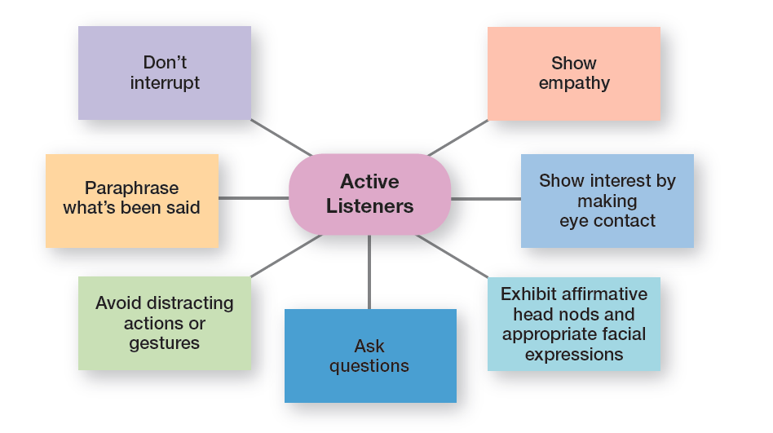
Exhibit 14-3
Active Listening Behavior
Specific behaviors that active listeners demonstrate are listed in Exhibit 14-3.
Notes:
Sources: Based on J. V. Thill and C. L. Bovee, Excellence in Business Communication, 9th ed. (Upper Saddle River, NJ: Prentice Hall, 2011), pp. 48–49; and S. P. Robbins and P. L. Hunsaker, Training in Interpersonal Skills, 5th ed. (Upper Saddle River, NJ: Prentice Hall, 2009), pp. 90–92.

Slide 12
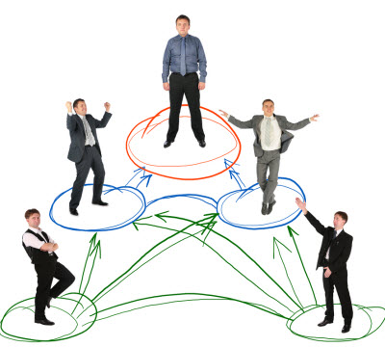
Direction of Communication Flow
Downward: communication that flows downward from a manager to employees
Upward communication: communication that flows upward from employees to managers
Lateral communication: communication that takes place among any employees on the same organizational level
Diagonal communication: communication that cuts across work areas and organizational levels
Notes:
CEOs at companies such as Starbucks and Apple use town hall meetings to communicate with employees. These town hall meetings are informal public meetings where top executives relay information, discuss issues, or bring employees together to celebrate accomplishments. These are examples of downward communication which is communication that flows from a manager to employees. It’s used to inform, direct, coordinate, and evaluate employees.
Upward communication is communication that flows from employees to managers. It keeps managers aware of how employees feel about their jobs, their coworkers, and the organization in general. Managers also rely on upward communication for ideas on how things can be improved. Some examples of upward communication include performance reports prepared by employees, suggestion boxes, employee attitude surveys, grievance procedures, manager–employee discussions, and informal group sessions in which employees have the opportunity to discuss problems with their manager or representatives of top-level management.
Communication that takes place among employees on the same organizational level is called lateral communication. In today’s dynamic environment, horizontal communications are frequently needed to save time and facilitate coordination. Cross-functional teams, for instance, rely heavily on this form of communication interaction.
Diagonal communication is communication that crosses both work areas and organizational levels. A credit analyst who communicates directly with a regional marketing manager about a customer’s problem—note the different department and different organizational level—uses diagonal communication.

Slide 13
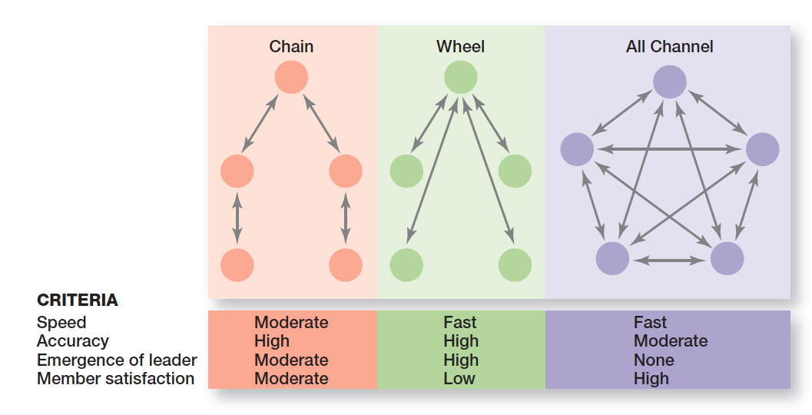
Communication networks
Communication networks: the variety of patterns of vertical and horizontal flows of organizational communication
Notes:
The vertical and horizontal flows of organizational communication can be combined into a variety of patterns called communication networks. In the chain network, communication flows according to the formal chain of command, both downward and upward. The wheel network represents communication flowing between a clearly identifiable and strong leader and others in a work group or team. The leader serves as the hub through whom all communication passes. Finally, in the all-channel network, communication flows freely among all members of a work team.
The grapevine is the informal organizational communication network. The grapevine is active in almost every organization. Is it an important source of information? You bet! One survey reported that 63 percent of employees say they hear about important matters first through rumors or gossip on the grapevine.

Slide 14
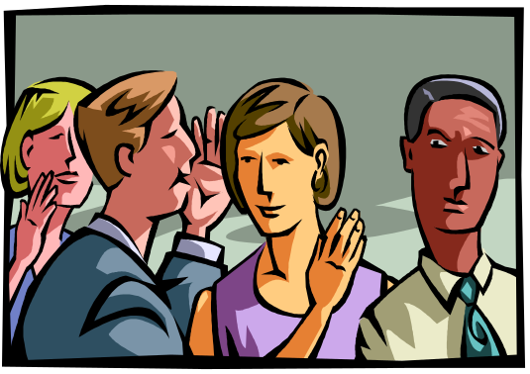
Communication networks
Grapevine - the informal organizational communication network.
Notes:
The grapevine is the informal organizational communication network. The grapevine is active in almost every organization. Is it an important source of information? You bet! One survey reported that 63 percent of employees say they hear about important matters first through rumors or gossip on the grapevine.

Slide 15
Workplace Design and Communication
Working From Anywhere
Open workplaces: workplaces with few physical barriers and enclosures
The 24/7 Work Environment
IT has made it possible for people in organizations to be fully accessible, at any time, regardless of where they are.
Choosing the Right Media
It is important for managers to understand the situations in which one or more media facilitates effective communication.
Notes:
Internet access is increasingly available through Wi-Fi and wireless access hotspots. And the number of these hotspot locations continues to grow.
With more than 50 million “mobile” workers in the United States, smartphones, notebook computers, computing devices such as iPad, and other pocket communication devices have generated whole new ways for managers to “keep in touch.” And the number of mobile communication users keeps increasing.
Employees don’t have to be at their desks to communicate with others in the organization. As wireless technology continues to improve, we’ll see more organizational members using it as a way to collaborate and share information.
There was a time not so long ago when most employees rarely communicated after traditional work hours. IT has made it possible to stay connected around the clock, seven days per week. And IT has radically changed the way organizational members communicate. For example, IT has significantly improved a manager’s ability to monitor individual and team performance, has allowed employees to have more complete information to make faster decisions, and has provided employees more opportunities to collaborate and share information.
In addition, IT has made it possible for people in organizations to be fully accessible, at any time, regardless of where they are. Employees don’t have to be at their desk with their computers running to communicate with others in the organization.

